Slide 1

Bootcamp Activity

Slide 2
You’ll gain a better appreciation of how software and hardware are crucially linked together.
You’ll get a feel for the university lab experience and its focus on teamwork and collaboration.
You’ll be exposed to the powerful technology of Arduino, a set C/C++ functions used to program devices.
Why participate?

Slide 3


Most Importantly
We want to help you bridge the gap between the experience of High School and University.
Today, you will get a small taste of what the next 4+ years may be like.

Slide 4
The Challenge
At Hand
Your team will build a motion operated array of lights with a digital counter
1. Wire the device using a schematic
2. Provide the code for the various functionalities (movement detection, light patterns, and countdown)
Notes:
Professional behaviour, confidentiality

Slide 5
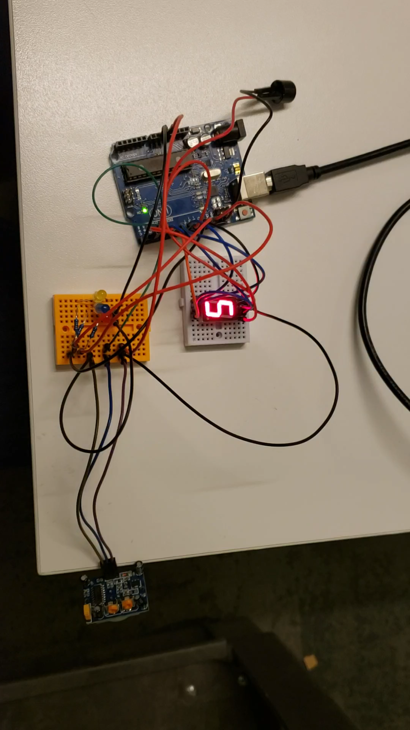
The Final Product
Notes:
Professional behaviour, confidentiality

Slide 6
Overview of Hardware Components

Slide 7
Review of Circuits
Basically, circuits are a way of conveying electricity
We ground a circuit to the Earth to prevent static buildup and electrical shock
We also use resistors to reduce the amount of voltage

Slide 8
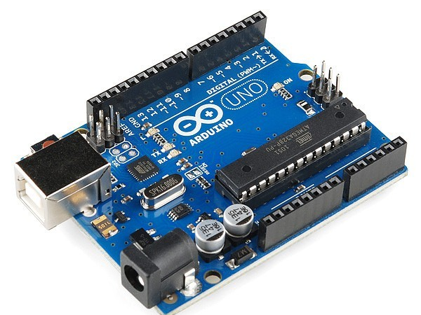
Microcontroller
A microcontroller is a circuit board that sends and receives instructions via electrical signals

Slide 9
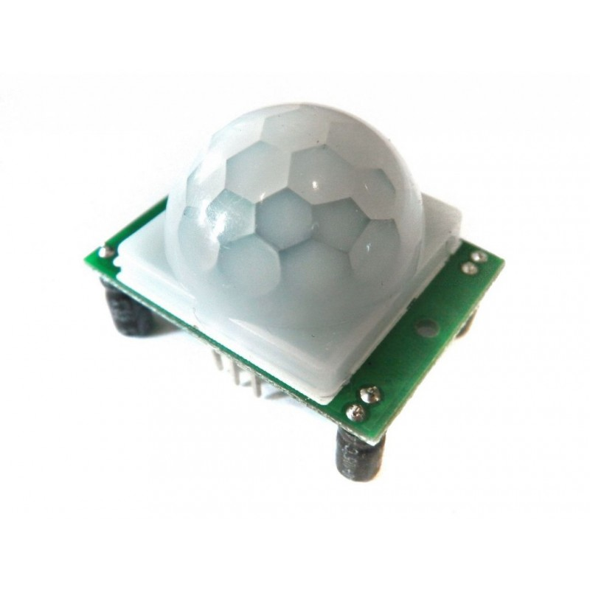
PIR Motion Sensor
A low voltage passive infrared sensor that collects data on the change in ambient infrared radiation within it’s vicinity.

Slide 10
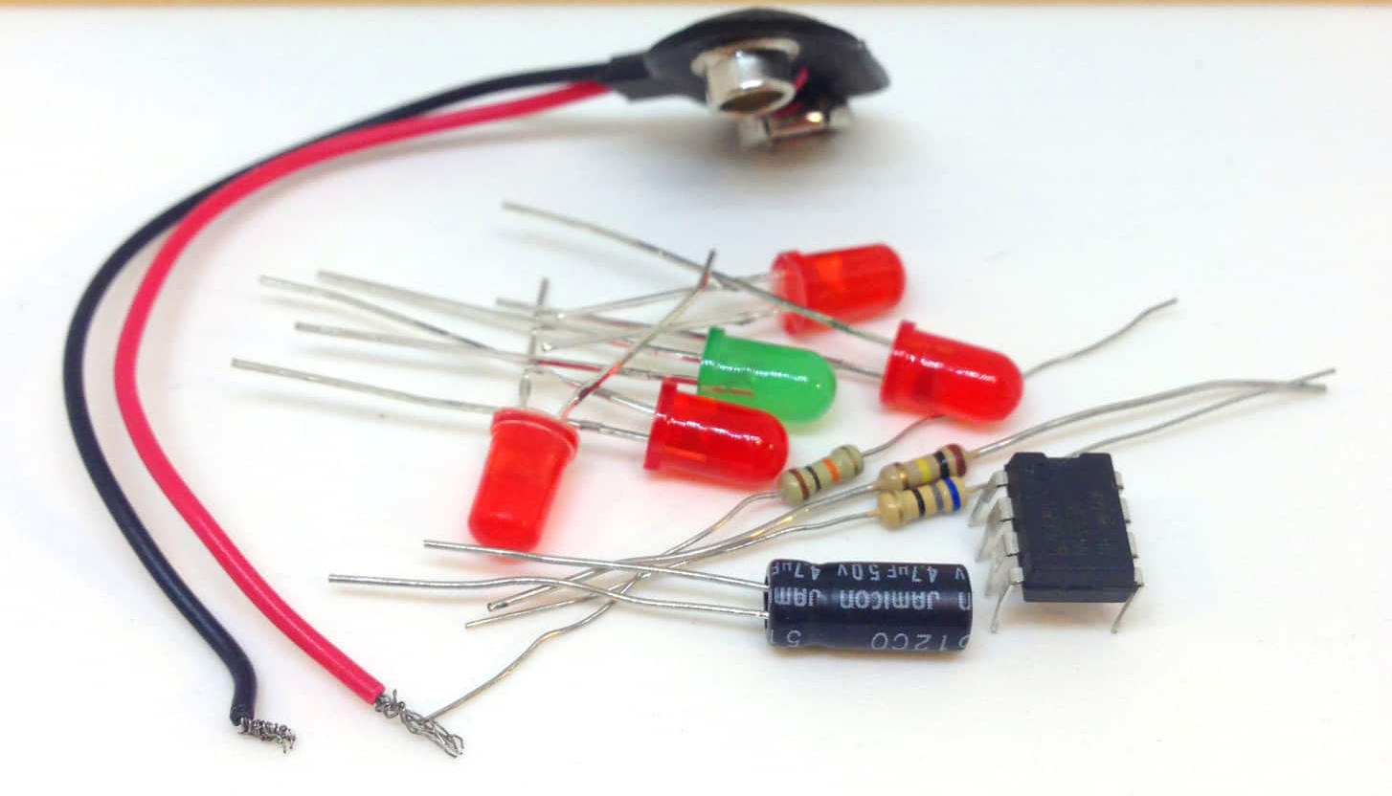

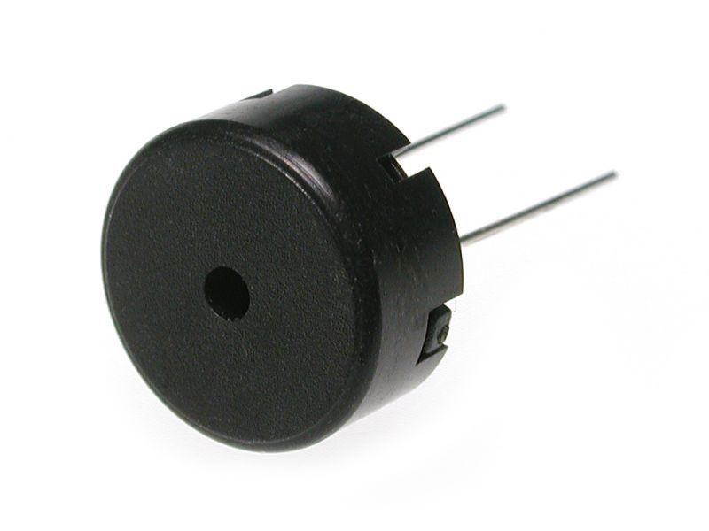
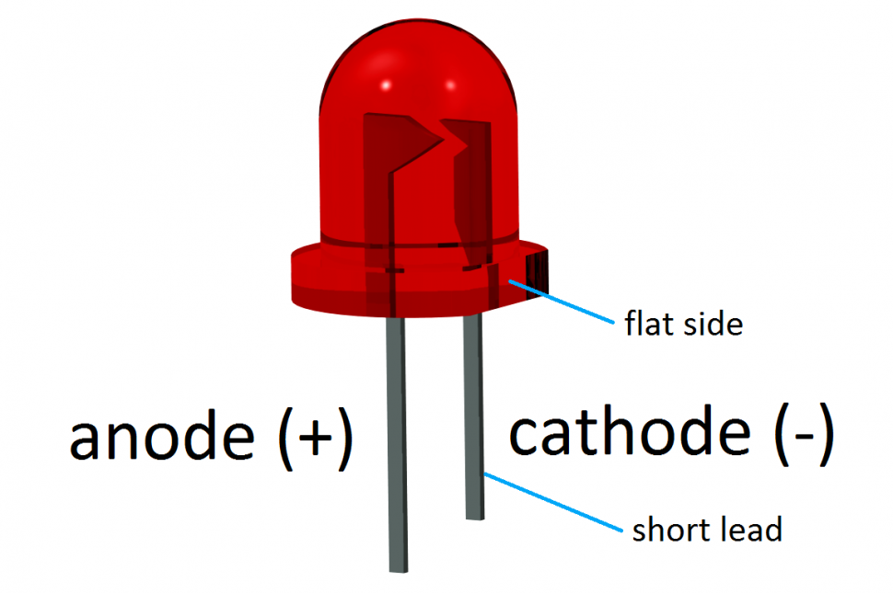
LED lights and Piezospeaker

Slide 11
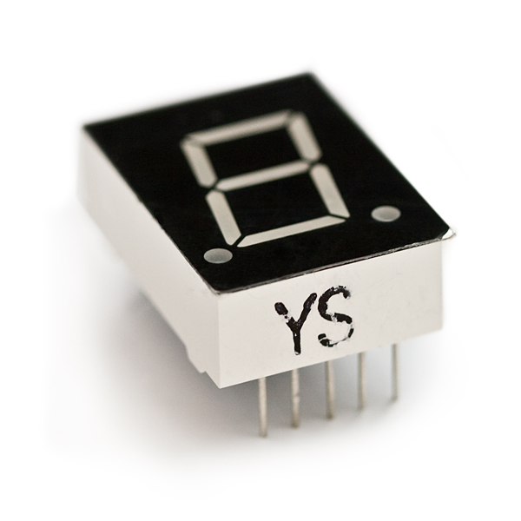
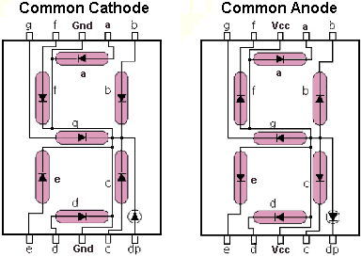
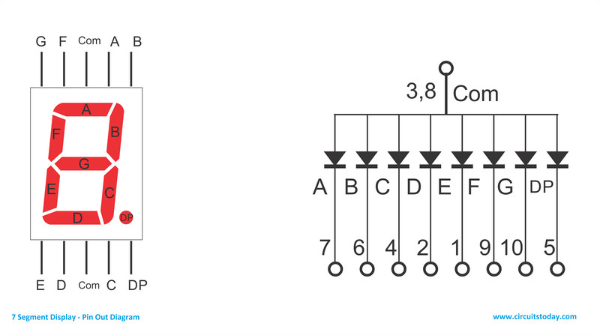
7 Segment Display

Slide 12
How do we connect “components”?

Slide 13
Breadboard
A breadboard allows you to build reusable circuits, providing “mounting holes” for wires and components
Under the hood, each “row” is really a horizontal strip of metal, which can be used to build a circuit

Slide 14
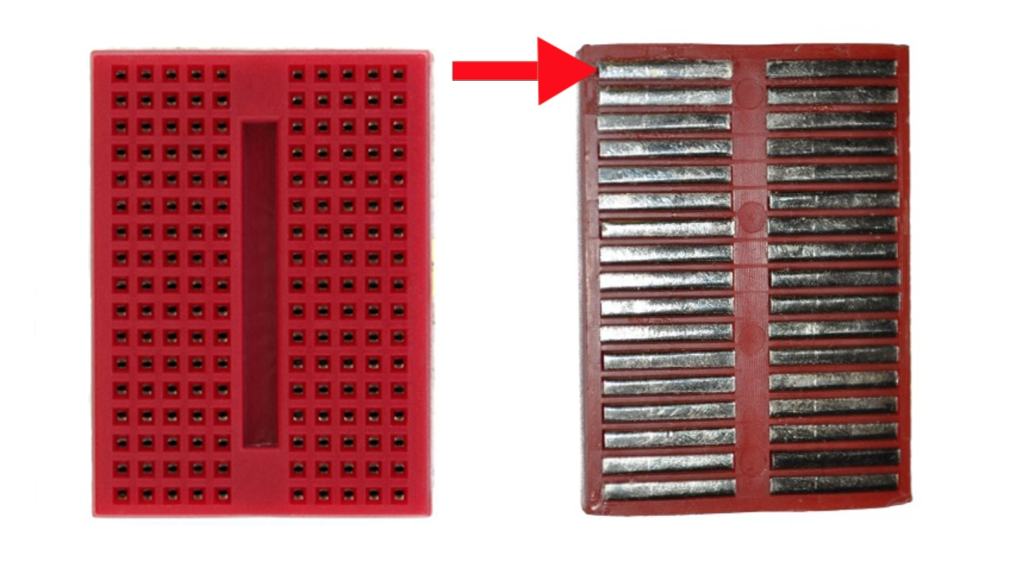
Breadboard

Slide 15
Schematic Diagrams
Schematic diagrams provide instructions on how to wire a circuit
You will use the schematic to wire the components to the Arduino motor shield

Slide 16
Overview of Arduino Syntax

Slide 17
Using Macros
In C/C++, we can also use the “pre-processor” to define constants without declaring initially their type
Useful for declaring “symbols”—we didn’t even have Boolean values in K&R C
#define TRUE 1;
# define GREETING “hello”;

Slide 18
Computation is all about conditionals.
Conditionals declare control flow of the program.
if ( motionDetected()){
beepSpeaker();
}
Conditionals

Slide 19
Arduino is just setup() and loop()
setup() initializes the variables, sets up pin modes, and starts using libraries of methods.
loop() maintains a set of instructions so long as there is power to the Arduino circuit board.

Slide 20
I/O Methods
digitalRead(pin)
digitalWrite(pin, val)
E.g., Sending power to a pin
digitalWrite(digitalPin, HIGH);

Slide 21
Our Pseudocode
digitalWrite(ledPin, HIGH); // Turns on LED delay(150);
digitalWrite(ledPin, LOW); // Turns off LED
delay(150);
digitalWrite(ledPin, HIGH);

Slide 22
Your Tasks
Code the movement detection, LED pattern, beeping, and the countdown timer.
Ideally, half of you will be responsible for each task.
Complete the wiring for the device.

Slide 23
Where are the Instructions?
lassondeorientation.wordpress.com for the slides, instructions, and language reference
Use the comments as a guide
Don't get stressed out if things don't work

